Slide 1
Personas

Slide 2
Theme of the day
When writing a novel a writer should create living people; people not characters. A character is a caricature.

Slide 3

Understanding your user
Literature review
Product marketing plans, brand strategy, market research, user surveys, technology specifications and white papers, business and technical journal articles, competitive studies
Web searches for related and competing products and news,
Usability study results and metrics
Customer support data such as call centre statistics.
The design team should collect this literature, use it as a basis for developing questions to ask stakeholders and SMEs, and later use it to supply additional domain knowledge and vocabulary, and to check against compiled user data.

Slide 4
Understanding your user
Stakeholder interviews:
Stakeholders are key members of the organization commissioning the design work.
Typically include executives, managers, and representative contributors from development, sales, product management, marketing, customer support, design, and usability.
To find out:
Preliminary product vision
Budget and schedule
Technical constraints and opportunities
Business drivers
Stakeholders’ perceptions of the user

Slide 5
Understanding your user
Subject matter expert (SME) interviews
Similar to stakeholders, SMEs can provide valuable perspectives on a product and its users
However designers should be careful to recognize that SMEs represent a somewhat skewed perspective.
often expert users.
knowledgeable, but they aren’t designers
necessary in complex or specialized domains.
You will want access to SMEs throughout the design process.

Slide 6
Understanding your user
Customer interviews
Don’t confuse users with customers
Important to understand customers and satisfy their goals in order to make a product viable.
Also important to realize that customers seldom actually use the product themselves, and when they do, they use it quite differently from the way their users do.

Slide 7
Understanding your user
When interviewing customers, you will want to understand:
Their goals in purchasing the product
Their frustrations with current solutions
Their decision process for purchasing a product of the type you’re designing
Their role in installation, maintenance, and management of the product
Domain-related issues and vocabulary

Slide 8
Understanding your user
User Interviews
The main focus of the design effort
Information we are interested in learning from users includes:
When, why, and how the product is or will be used
Domain knowledge from a user perspective: What do users need to know to achieve their goals?
Goals and motivations for using the product
Mental model: how users think about their jobs and activities, as well as what expectations users have about the product
Problems and frustrations with current products (or an analogous system if no current product exists)

Slide 9
Understanding your user
User observation
Combining interviewing and observation, allows designers to ask clarifying questions and direct inquiries about situations and behaviours they observe in real time.
Product and competitive audits
Examine any existing version or prototype of the product, as well as its chief competitors.
Doing so gives the design team a sense of the state of the art

Slide 10
Target Audience - Personas
A persona is a way to model, summarise and communicate research about people who have been observed or researched in some way.
A persona is depicted as a specific person but is not a real individual; rather, it is synthesised from observations of many people.
Each persona represents a significant portion of people in the real world and enables the designer to focus on a manageable and memorable cast of characters, instead of focusing on thousands of individuals.
Personas aid designers to create different designs for different kinds of people and to design for a specific somebody, rather than a generic everybody.

Slide 11
Personas
Use your research to construct user models or Personas.
Personas are composite archetypes based on behavioural data gathered from the many actual users encountered the research phase.
In order to satisfy a diverse audience of users, logic might tell you to make it as broad in its functionality as possible to accommodate the most people.
This logic, however, is flawed. The best way to successfully accommodate a variety of users is to design for specific types of individuals with specific needs.

Slide 12
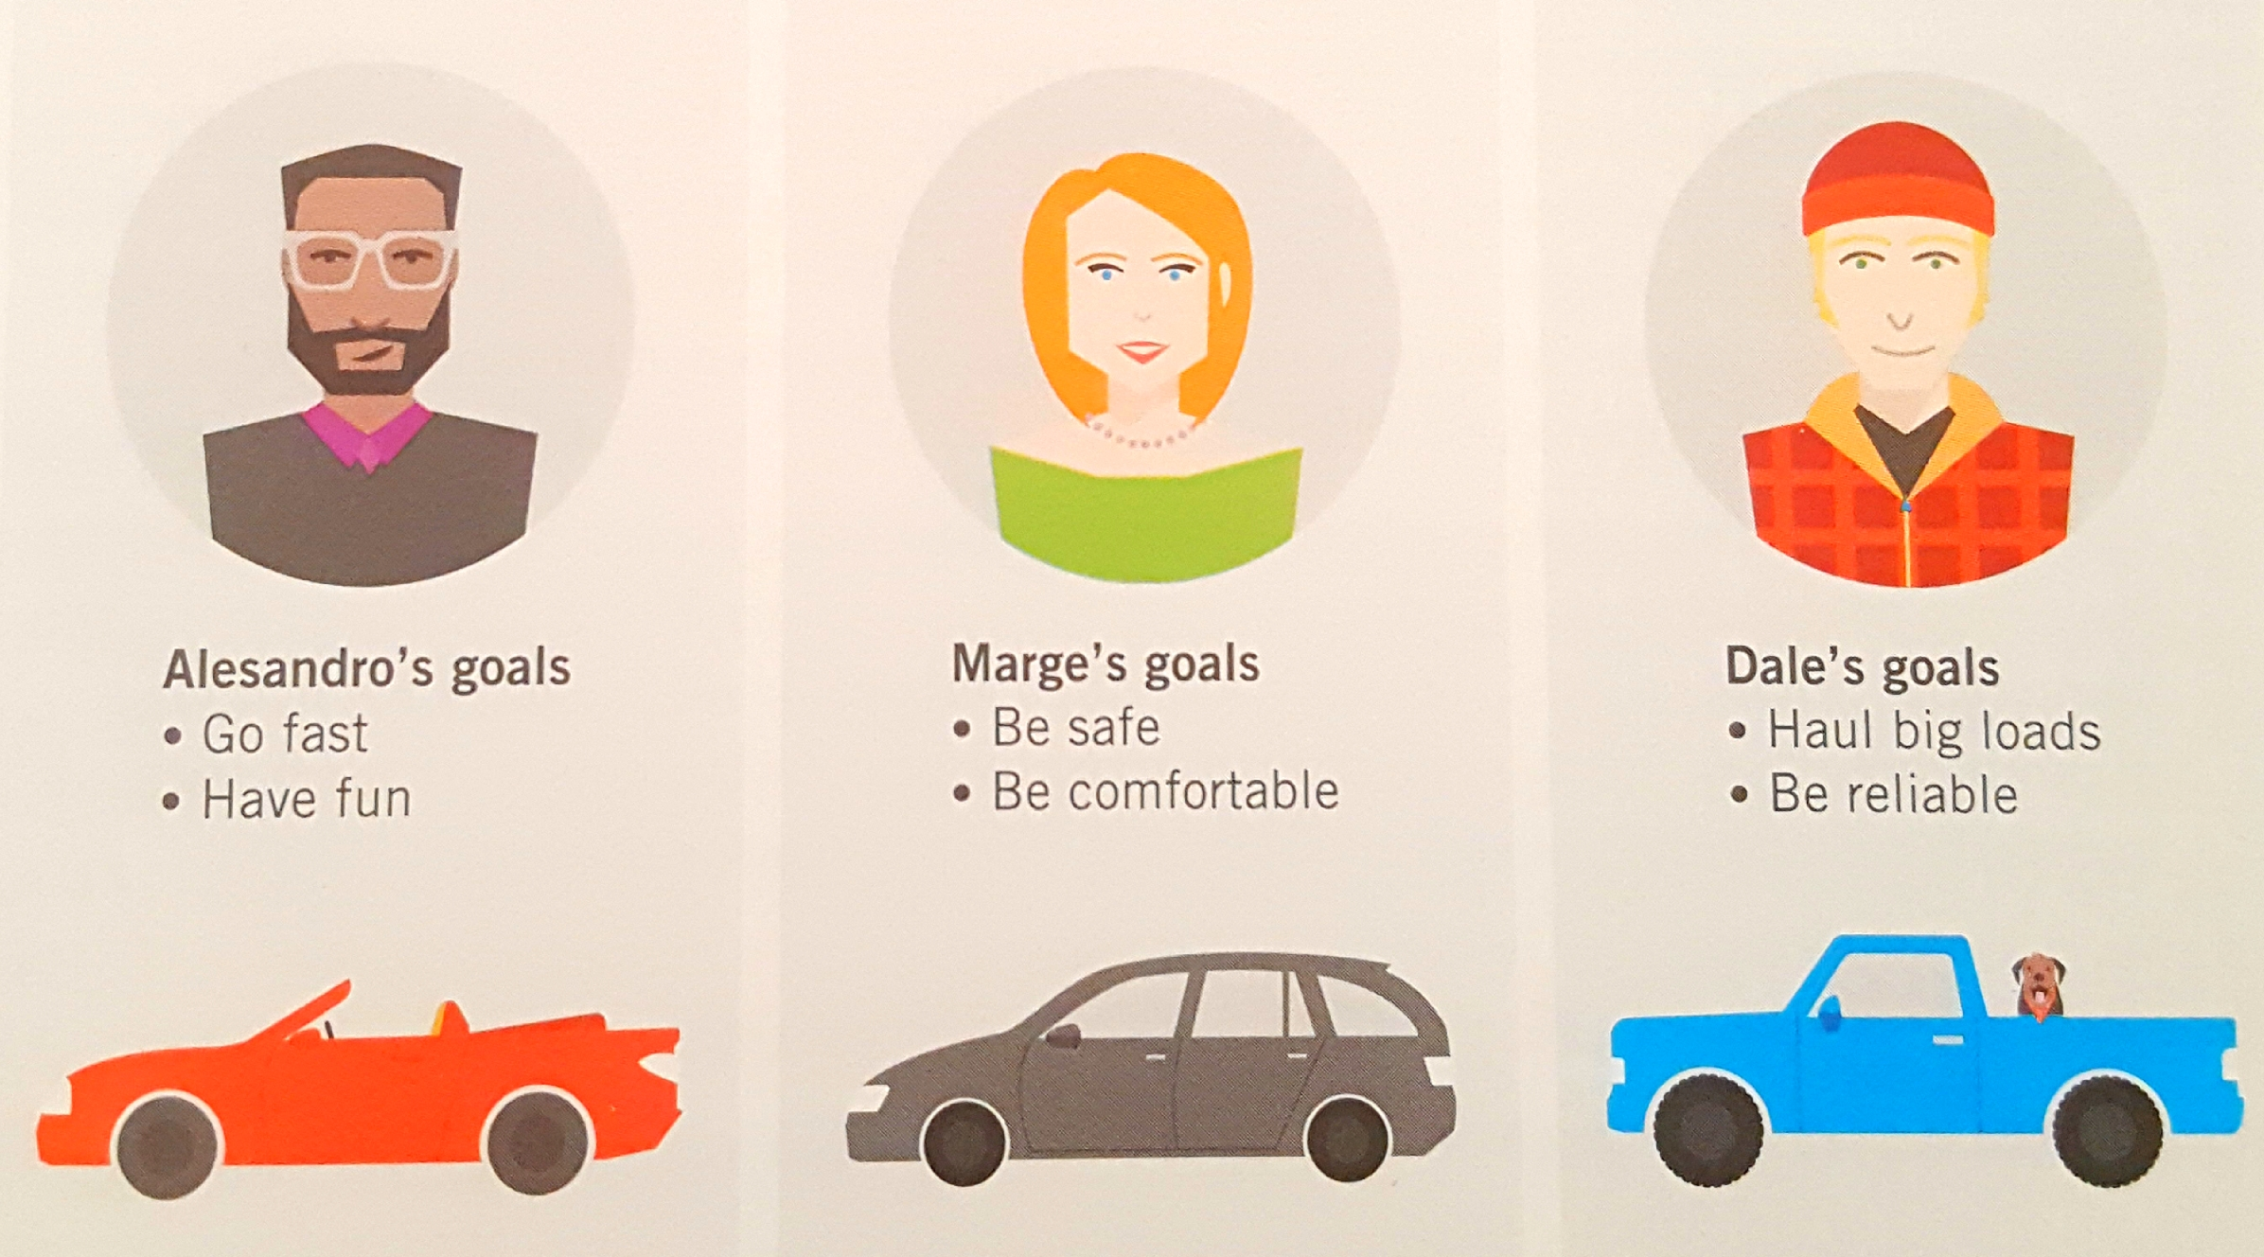
User goals

Slide 13
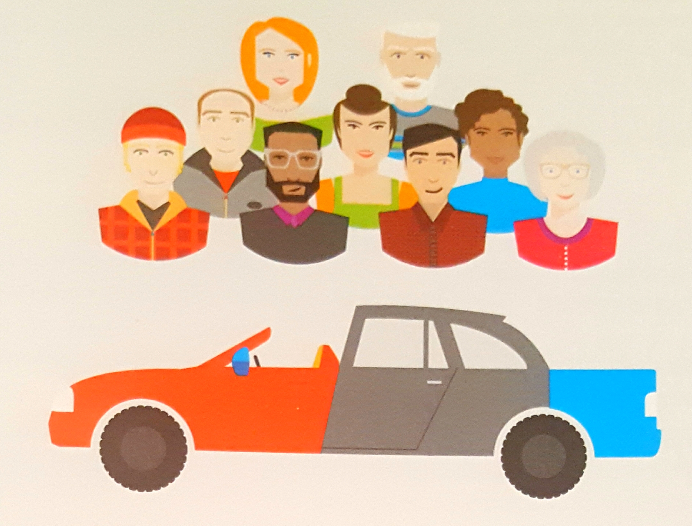
Cannot satisfy everyone

Slide 14
Personas are represented as individual people
The key to this approach is first to choose the right individuals to design for - those users whose needs best represent the needs of a larger set of key constituents.
Although personas are depicted as specific individuals, because they function as archetypes, they represent a class or type of user of a specific interactive product.
A persona encapsulates a distinct set of behaviour patterns, which are identified through the analysis of interview data, and supported by supplemental quantitative data as appropriate.
These patterns, along with specific motivations or goals, define our personas

Slide 15
Personas are represented as individual people
Personas are user models that are represented as specific, individual human beings.
They are not actual people but are synthesized directly from observations of real people.
This is appropriate and effective because of the unique aspects of personas as user models: They engage the empathy of the design and development towards the human target of the design.

Slide 16
Personas are based on research
Interviews with users outside of their use contexts
Information about users supplied by stakeholders and subject matter experts (SMEs)
Market research data such as focus groups and surveys
Market-segmentation models
Data gathered from literature reviews and previous studies

Slide 17
Personas must have goals
Understanding personas is more about understanding motivations and goals than it is about understanding specific tasks or demographics.
Experience goals: how a user wants to feel
End goals: what a user wants to do
Life goals: who a user wants to be

Slide 18
Constructing Personas
Identify
Identify behavioural variables.
Map
Map interview subjects to behavioural variables.
Identify
Identify significant behaviour patterns.
Synthesize
Synthesize characteristics and relevant goals.
Check
Check for redundancy and completeness.
Expand
Expand description of attributes and behaviours.
Designate
Designate persona types.

Slide 19
Step 1: Identify behavioural variables
Activities -What the user does; frequency and volume
Attitudes -How the user thinks about the product domain and technology
Aptitudes -What education and training the user has; capability to learn
Motivations -Why the user is engaged in the product domain
Skills -User capabilities related to the product domain and technology

Slide 20
Step 2: Map interview subjects to behavioural variables
This is about figuring out what behavioural variables are most prevalent.
Some of variables will represent a continuous range of behaviour (for instance, from a computer novice to a computer expert), and a few will represent multiple discrete choices (e.g., uses a smart TV or not).

Slide 21
Step 3: Identify significant behaviour patterns
Look for clusters of subjects that occur across multiple ranges or variables.
A set of subjects who cluster in six to eight different variables will likely represent a significant behaviour pattern that will form the basis of a persona.

Slide 22
Step 4: Synthesize characteristics and relevant goals
Identify
For each significant behaviour pattern you identify, you must synthesize details from your data.
Describe
Describe the potential use environment, typical workday (or other relevant context), current solutions and frustrations, and relevant relationships with others.
Summarize
Brief bullet points describing characteristics of the behaviour are sufficient. Stick to observed behaviours as much as possible

Slide 23
Step 4: Synthesize characteristics and relevant goals
One fictional detail at this stage is important: the personas’ first and last names.
The name should be evocative of the type of person the persona is, without tending toward caricature or stereotype.
You can also, at this time, add in some demographic information such as age, geographic location, relative income (if appropriate), and job title.
This information is primarily to help you visualise the persona better as you assemble the behavioural details. From this point on, you should refer to the persona by his or her name.

Slide 24
Step 4: Synthesise characteristics and relevant goals
Synthesising goals
By identifying the logical connections between each persona’s behaviours, you can begin to infer the goals that lead to those behaviours.
You can infer goals both
by observing actions (what interview subjects in each persona cluster are trying to accomplish and why) and
by analysing subject responses to goal-oriented interview questions

Slide 25
Step 4: Synthesize characteristics and relevant goals
Goals must always directly relate, in some way, to the product being designed.
Typically, the majority of useful goals for a persona are end goals (3-5).
Life goals are most useful for personas of consumer-oriented products, but they can also make sense for enterprise personas in transient job roles. (0-1)
General experience goals such as “don’t feel stupid” and “don’t waste time” can be taken as implicit for almost any persona. Occasionally, a specific domain may dictate the need for more specific experience goals (0-2).

Slide 26
Step 5: Check for completeness and redundancy
Check your mappings and personas’ characteristics and goals to see if there are any important gaps that need filling.
Are any political personas that you need to add to satisfy stakeholder assumptions or requests
Each persona must vary from all others in at least one significant behaviour.
If you find that two personas seem to vary only by demographics, you may choose to eliminate one of the redundant personas or tweak their characteristics to make them more distinct.

Slide 27
Step 6: Expand description of attributes and behaviours
Your list of bullet point characteristics and goals arrived at in Step 4 points to the essence of complex behaviours, but leaves much implied.
Third-person narrative is far more powerful at conveying the persona’s attitudes, needs, and problems to other team members.
This narrative should be no longer than one or two pages of prose.

Slide 28
Step 6: Expand description of attributes and behaviours
The best narrative quickly introduces the persona in terms of his job or lifestyle, and briefly sketches a day in his life, including peeves, concerns, and interests that have direct bearing on the product.
Details should be an expansion of your list of characteristics, with additional data derived from your observations and interviews.
The narrative should express what the persona is looking for in the product by way of a conclusion.

Slide 29
Step 6: Expand description of attributes and behaviours
When you start developing your narrative, choose photographs of your personas. Photographs make them feel more real as you create the narrative and engage others on the team when you are finished.

Slide 30
Step 7: Designate persona types
Prioritise your personas to determine which should be the primary design target.
Primary - a single persona from the set whose needs and goals can be completely and happily satisfied by a single interface without disenfranchising any of the other personas.

Slide 31
Step 7: Designate persona types
Secondary - mostly satisfied with the primary persona’s interface but has specific additional needs that can be accommodated without upsetting the product’s ability to serve the primary persona.
Supplemental - needs are completely represented by a combination of primary and secondary personas and are completely satisfied by the solution we devise for one of our primaries.

Slide 32
Step 7: Designate persona types
Customer - address the needs of customers, not end users
Served - not users of the product at all; however, they are directly affected by the use of the product. Provide a way to track second-order social and physical ramifications of products
Negative - specific types of users that the product is not being built to serve. They aren’t users of the product. Their use is purely rhetorical: to help communicate to other members of the team that a persona should definitely not be the design target for the product.

Slide 33
When rigorous personas aren’t possible: Provisional personas
Rhetorical tools to clearly communicate assumptions about who the important users are and what they need, and to enforce rigorous thinking about serving specific user needs (even if these needs are not validated).
Rely on available data and designer best guesses about behaviours, motivations, and goals.
Typically based on a combination of stakeholder and subject matter expert knowledge of users (when available), as well as what is understood about users from existing market data.

Slide 34
Provisional Personas
Using provisional personas yields better results than no user models at all.
Can help focus the product team and build consensus around product features and behaviours.
Caveats: if you do not have data to back up your assumptions you may:
Focus on the wrong design target
Focus on the right target, but miss key behaviours that could differentiate your product
Have a difficult time getting buy-in from individuals and groups who did not participate in their creation
Discredit the value of personas, causing your organization to reject the use of personas in the long term

Slide 35
Provisional Personas
If you are using provisional personas, it’s important to:
Clearly label and explain them as such
Represent them visually with sketches, not photos, to reinforce their provisional nature
Try to make use of as much existing data as possible (market surveys, domain research, subject matter experts, field studies, or personas for similar products)
Document what data was used and what assumptions were made
Steer clear of stereotypes (more difficult to do without field data)
Focus on behaviours and motivations, not demographics

Slide 36
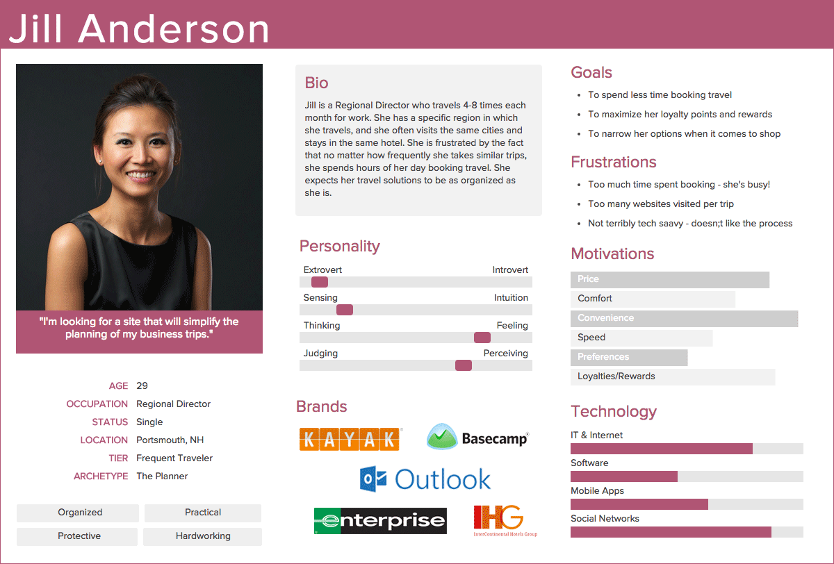
What Does A Persona Look Like?
https://xtensio.com/user-persona/

Slide 37
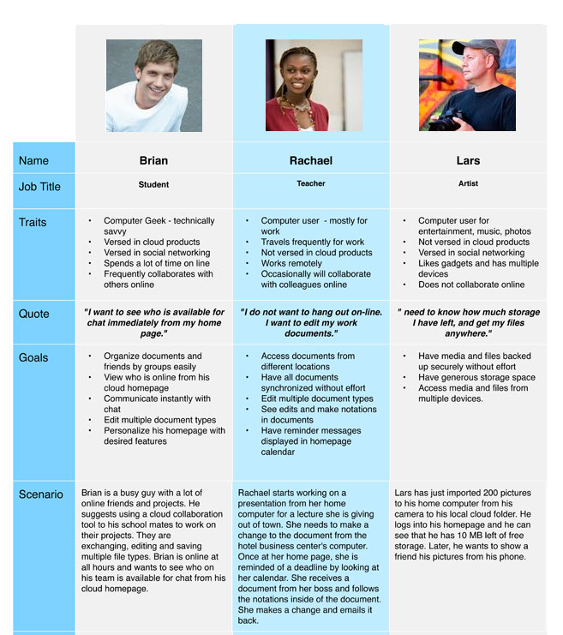
What Does A Persona Look Like?
http://www.loritompkins.com/v3/uxresearch-method.html

Slide 38
What Does A Persona Look Like?
While a persona is usually presented as a one-pager document, it is more than just a deliverable — it is a way to communicate and summarize research trends and patterns to others.
This fundamental understanding of users is what’s important, not the document itself.

Slide 39
Archetypes and stereotypes
Archetypes defined by:
their goals
their underlying psychology
what they are trying to achieve
Stereotypes defined by:
their behaviour
their emotions
how we connect to them

Slide 40
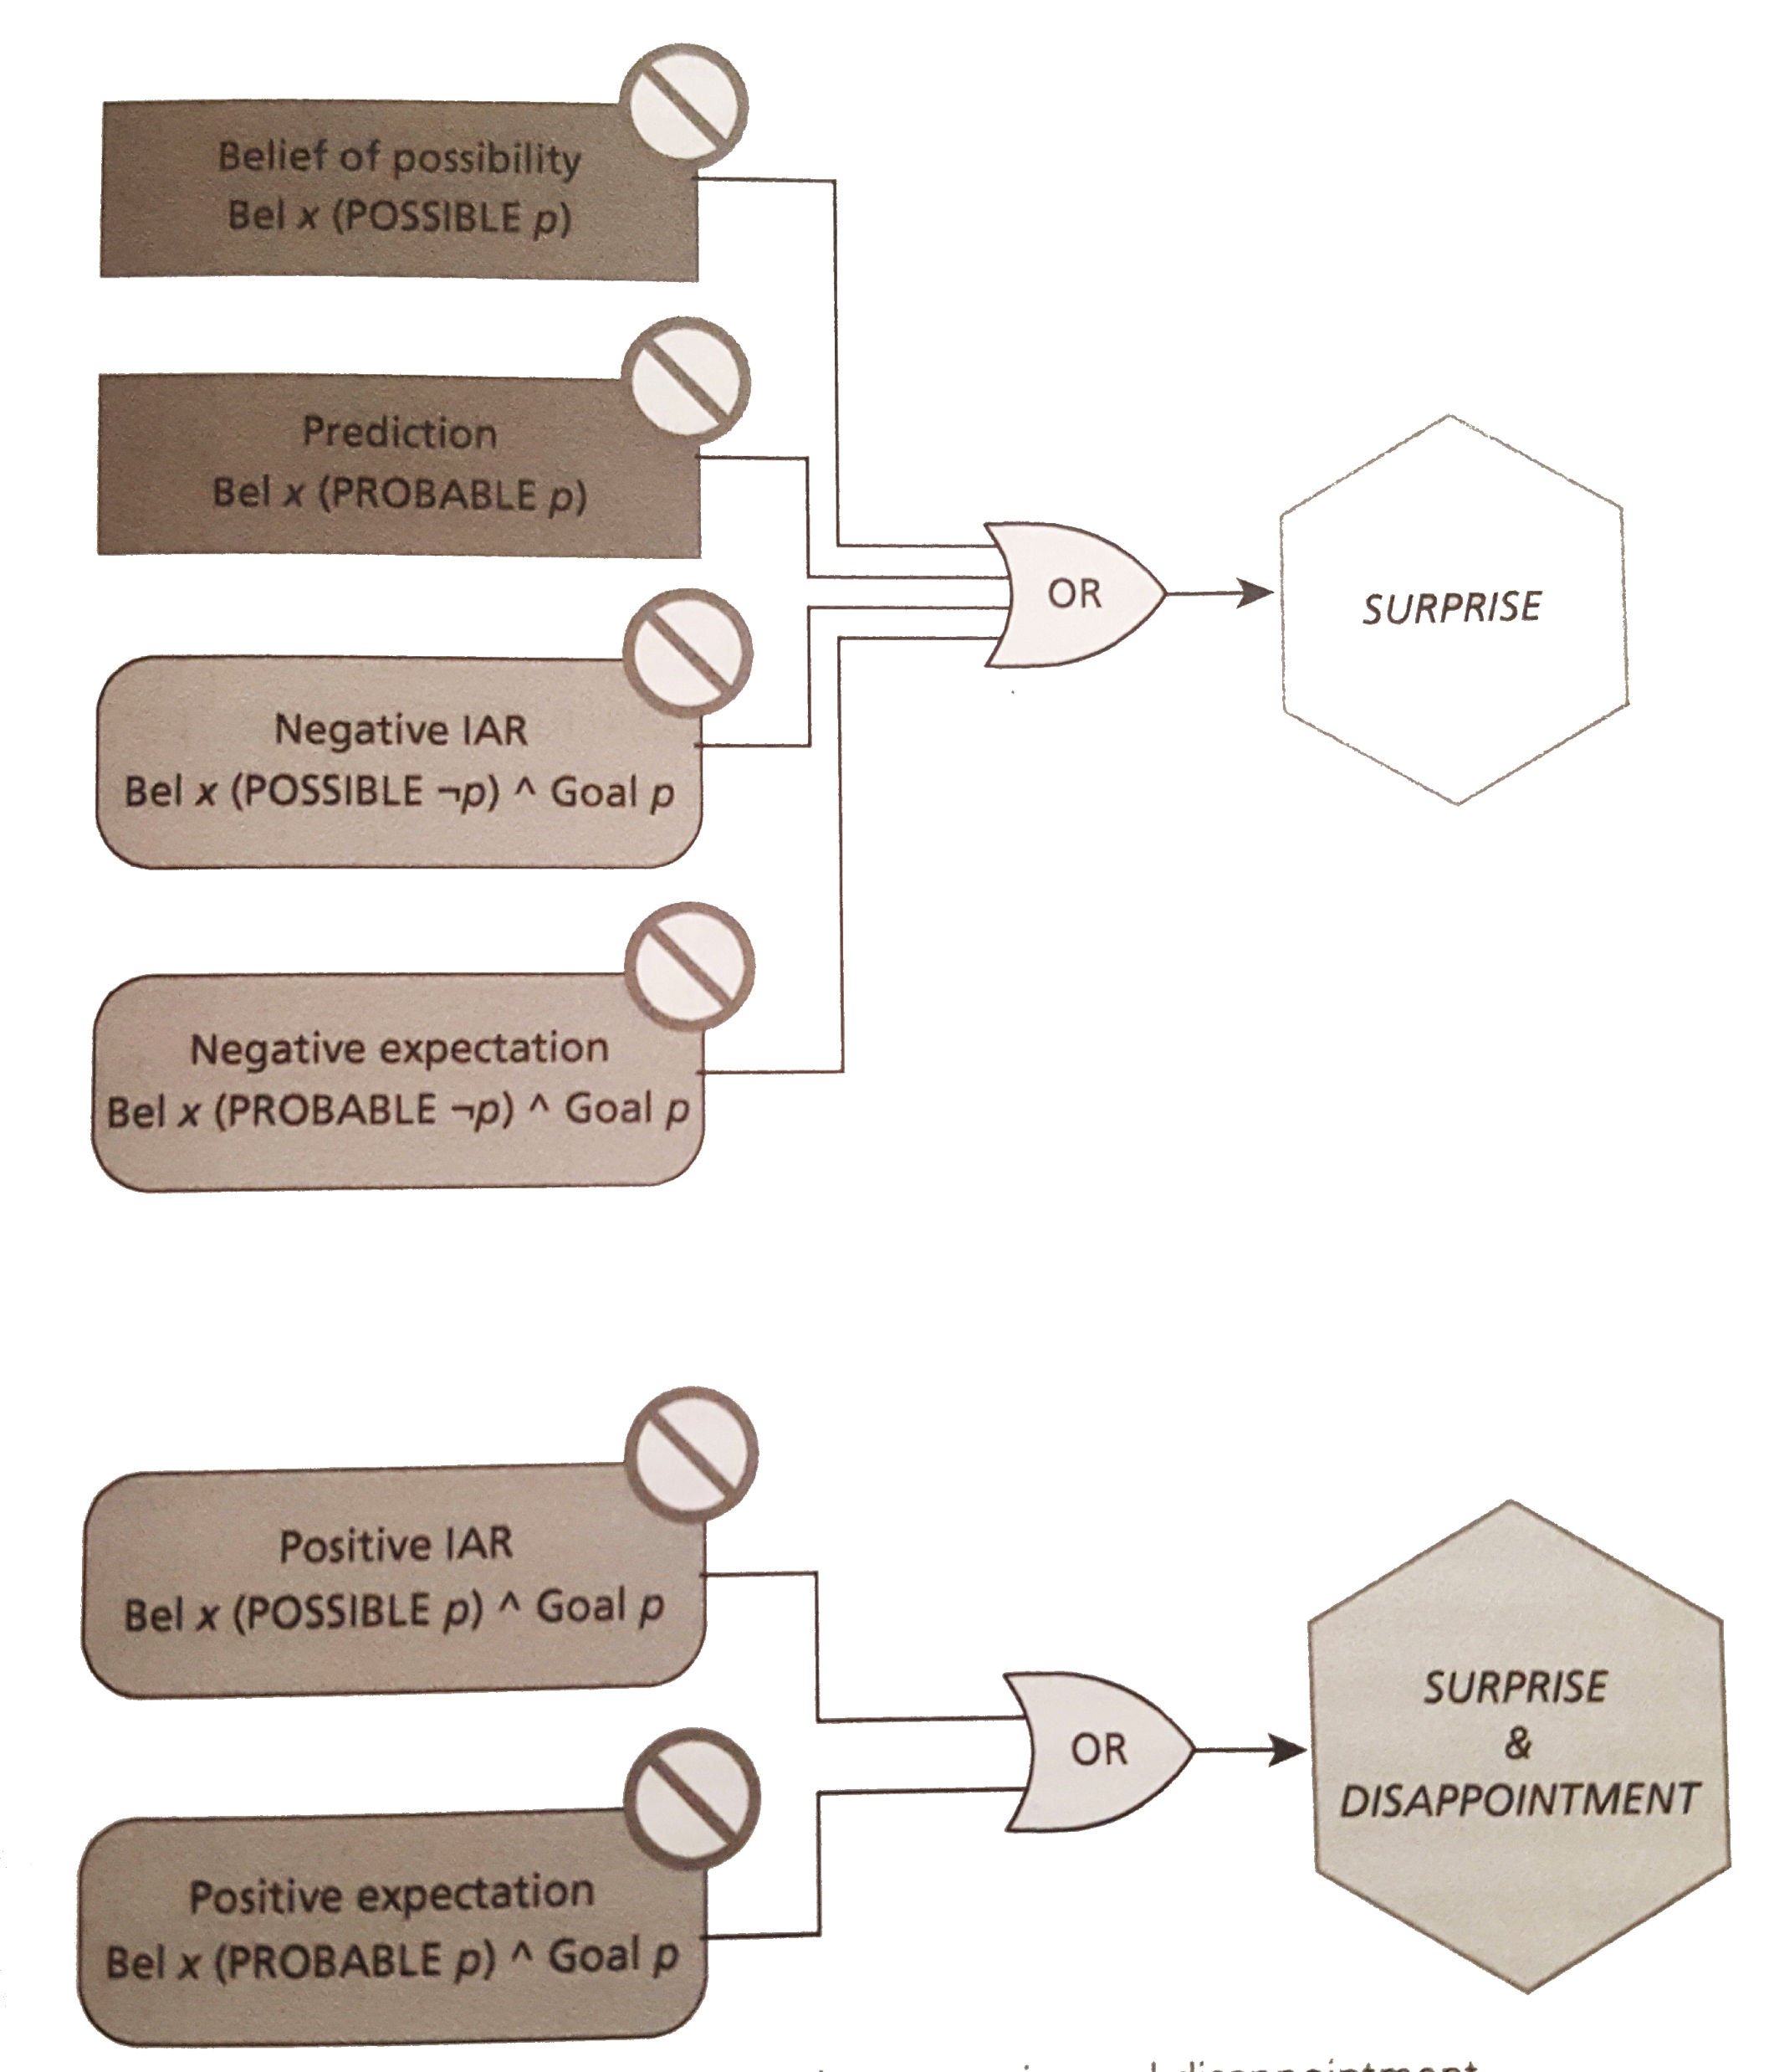
Formalising goals

Slide 41
Formalising goals
Imagine a user that uses a product when curious about something
From a psychological point of view, curiosity reflects the desire to close inherently unpleasant information gaps
This desire, however, depends on the perceived likelihood that the gap will be closed by accessing information
The amount of pre-existing knowledge in a particular domain may impact on the perceived likelihood of closure
This implies that curiosity may arise not only by increasing the amount of information available, but also by reducing the perceived size of the domain

